Slide 1
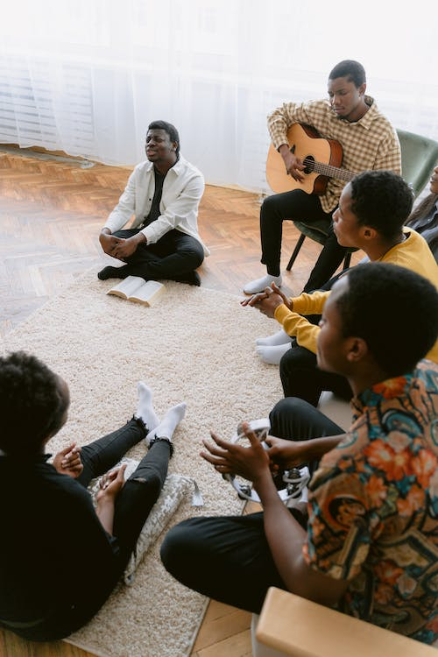
Patrick Freeman
MATUL520
Poor People’s Church Worship
December, 2022

Slide 2
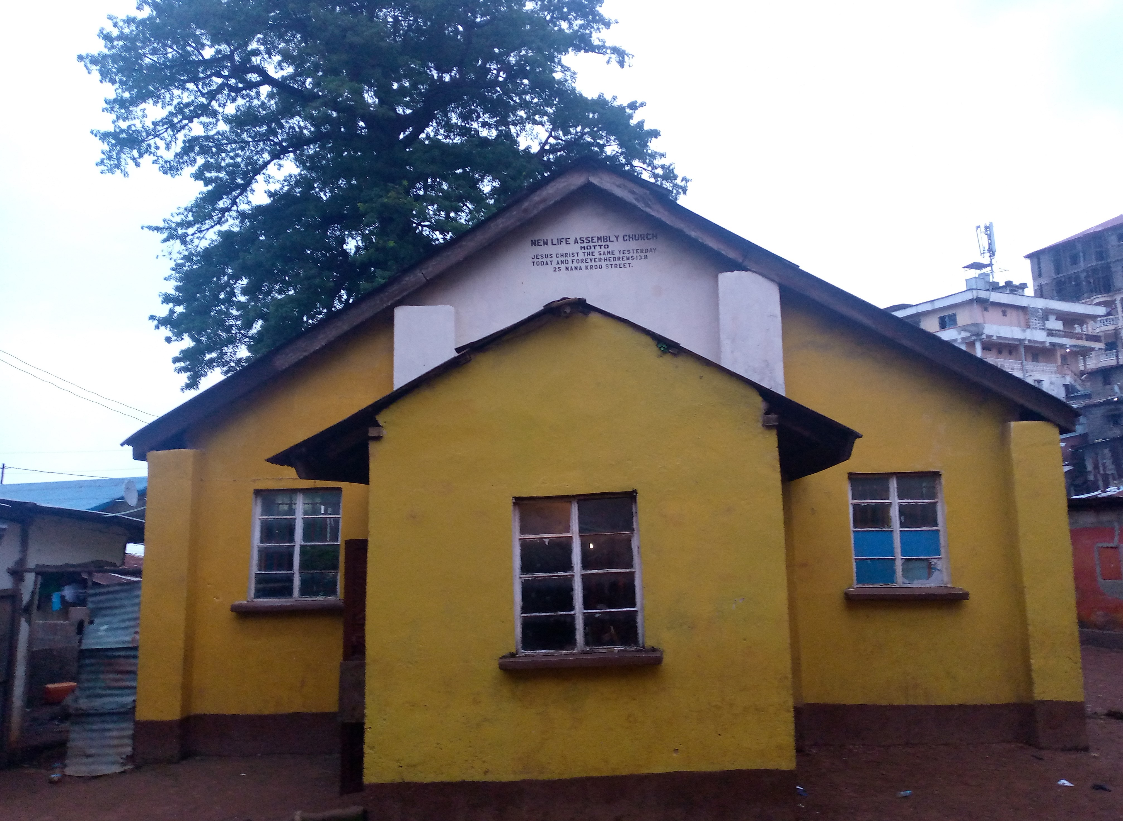
Slum Community
Short History
The oldest church in Kroo Bay Slum
An evangelistic ministry approach
Founded by the Kroo people from Liberia
Relocation of slave trade to Freetown
Focus on salvation and felt need
The poor in slum communities

Slide 3
Urban Slum Vs Non-Slum Community
Church in the City Slum/ Church Out of the City Slum Contrasts
Slum Community Church
Urban Community
Lively
Easily accessible
Full of community
Liberal
Informal
Extended families
Poor
Experimental
Generous
Friendly
Small congregation
Quiet
Isolated
Full of community
Conservative
Formal
Extended families
Poor
Traditional
Generous
Friendly
Large congregation

Slide 4

Slum Community Church Styles in Context
Church & Administrative Setup
Slum Community Church seeks to incarnate Jesus by serving and dwelling among the poorest of the poor in the Kroo Bay slum community
Urban societies- Church as community
Senior Pastor/ Assistant Pastors
Associate Pastors/ Deacon & Deaconesses
Urban- Congregation
Group (Consensus) Making Decision
Slum dwellers are mainly local businessmen of the city

Slide 5
What Does the Poor People’s Church Look Like?
(Economics, Housing, Education, Health & Family)
Slum Community Church Kroo Bay Slum
High rate of unemployment and underemployment
Low wages
Lack of medical care
75% illiterate rate
85% unmarried
Too many children born out of wedlock
Use of secondhand
Domestic and gender violence
Corrugated iron houses
Natural disaster
Basic hygiene facilities are of poor quality
Live in overly crowded places
High maternity rate
Hopelessness and despair
Separation of married couples
Short life expectancy
Food scarcity
Lack of resources
Lack of property
Lack of savings

Slide 6
Characteristics of the Culture of Poverty
(Psychology)
Slum Community Church
Slum Dwellers
The Church’s Response
Rejection
Abandonment
Loneliness
Hopelessness
Worthlessness (cloak of shame)
Insecurity
Grief
Inferiority complex
Poverty (hoarding, constant sense of not enough, survivalist mentality)
Prostitution and drug abuse
Secret societies and witchcraft practices
God is always willing to accept us irrespective of our status
He never leaves us or forsakes us, Hebrews 13:5
We are not alone, He is still with us
Be confident and optimistic for the Lord our God is with us
We are His precious pearl, Matthew 13:46
Has given us a spirit of boldness, power and love, 2 Tim 1:7
He actually grieves with us—loving us every step of the way
Self-assurance
Godliness with contentment is great gain 1 Tim 6:6
He has the power to set us free from spiritual and moral defilement
We are safe under the shadow of His wings, Psalm 91

Slide 7

Leadership Development
Among the Poor- Slum Community Church
Spiritual leadership
Strategic leadership
Servant leadership
Self-leadership
Shared leadership
Structural leadership
Sensory leadership

Slide 8
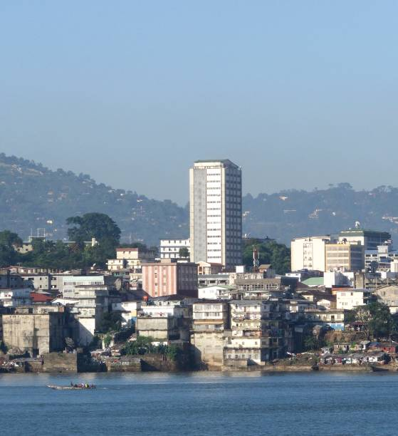
BIG IMAGE
Freetown, the Capital City of Sierra Leone

Slide 9

BIG IMAGE
Kroo Bay Slum, Freetown, Sierra Leone

Slide 10

THANK YOU!
Patrick Freeman
Phone:
+232-794-890-71
Email:
patrickfreemans@gmail.com

